Slide 1






The Netherlands eScience Center

Slide 2

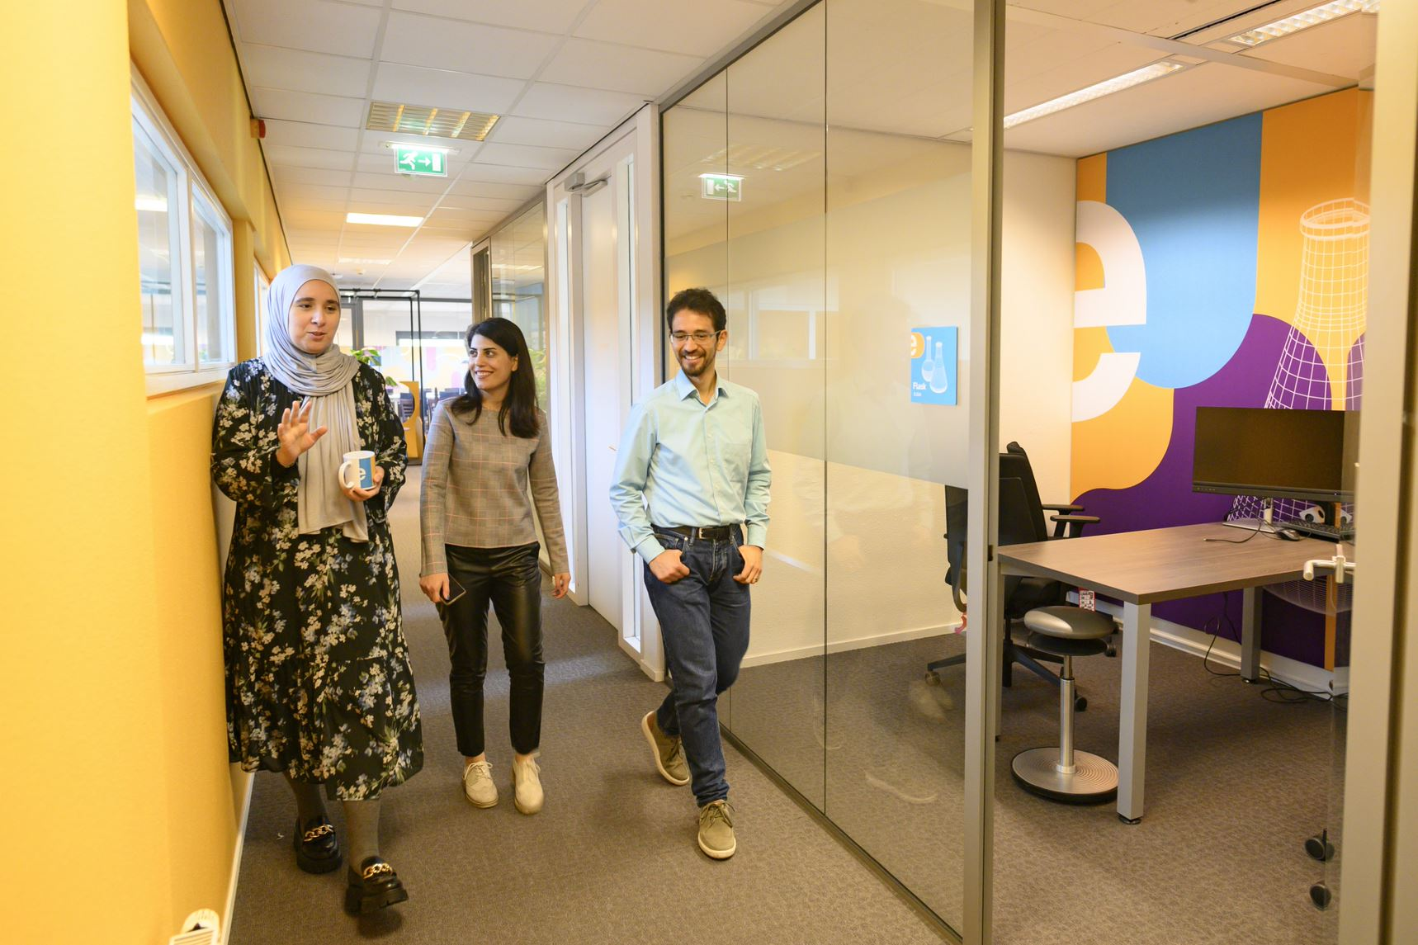

Who are we?
The Netherlands eScience Center is a national center for innovative software solutions in academic research.
Established to bridge the gap between digital technologies and scientific and scholarly inquiry.
Our Research Software Engineers
help researchers interpret results,
make tools and methods reusable for the wider research community,
co-author research and methodological publications.

Slide 3

Digital Skills Programme​​
Hands-on courses, 2-3 days
In person & online
Based on The Carpentries & CodeRefinery, and
In-house developed materials.
Topics cover:
Open & Reproducible Research Software
Intermediate and Advanced Research Software Skills
Advanced Technologies (e.g. GPUs, Deep Learning)
Schedule 2023
January | Data Analysis and Visualisation in Python for Researchers Machine learning in Python with scikit-learn | July | Parallel Programming with Python
March | Reproducible research with R packages Intermediate Research Software Development with Python Astronomical Data Science with Python | August | Introduction to Deep Learning
April | Parallel Programming with Python GPU programming | September | Reproducible research with R packages
May | Introduction to Geospatial Raster and Vector Data with Python Introduction to Deep Learning | October | Good Practices in Research Software Development (CodeRefinery Introduction to Geospatial Raster and Vector Data with Python
June | Image Processing with Python Good Practices in Research Software Development (CodeRefinery) | November | GPU programming Machine learning in python with scikit-learn Intermediate Research Software Development with Python

Slide 4
See upcoming workshops: esciencecenter.nl/events/?f=workshopsnl/events/?
To be notified about coming up workshops, subscribe to the Newsletter: eepurl.com/dtjzwP

Slide 5
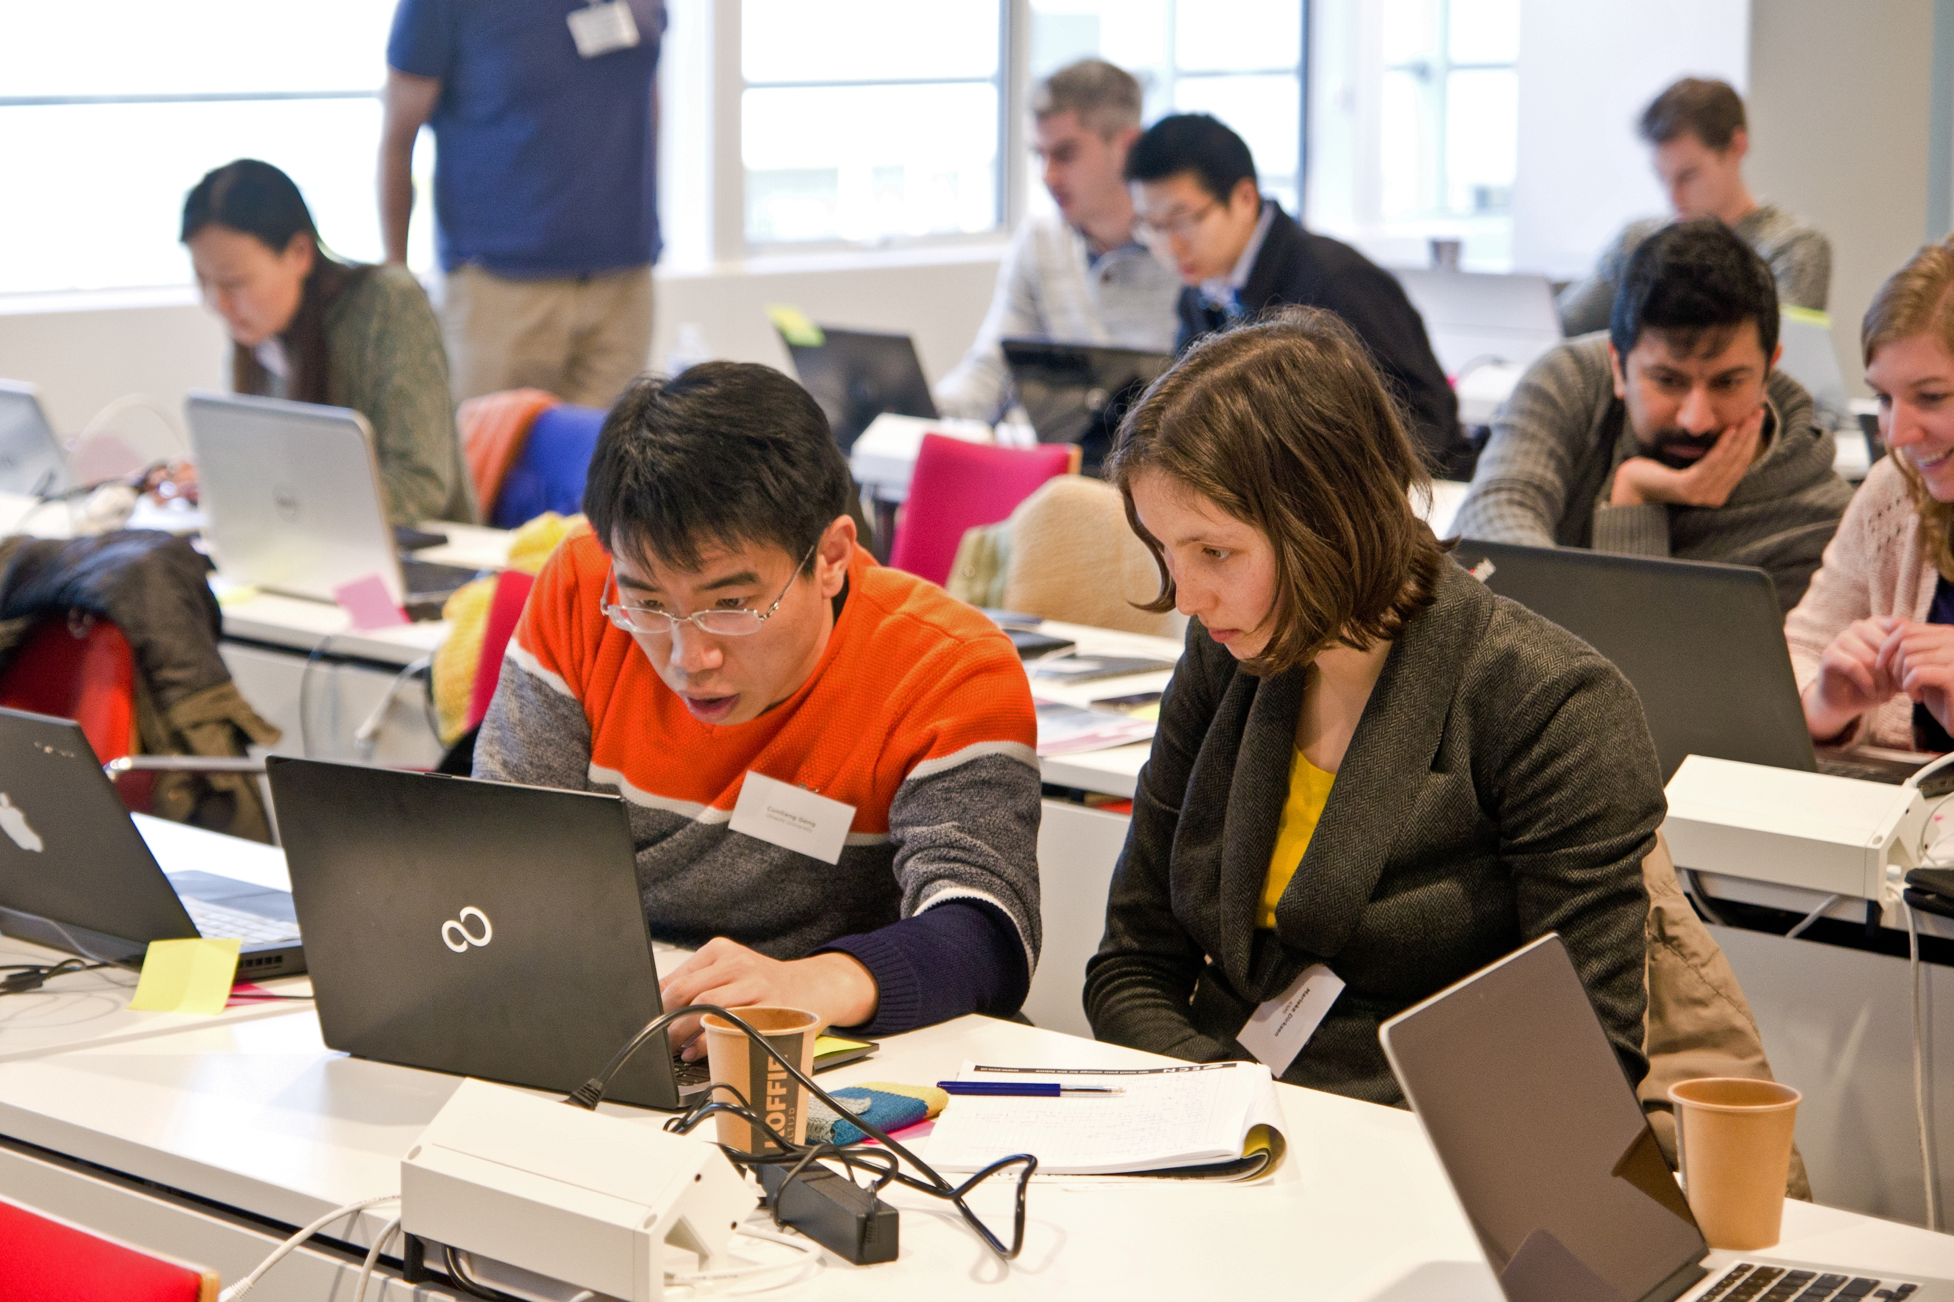


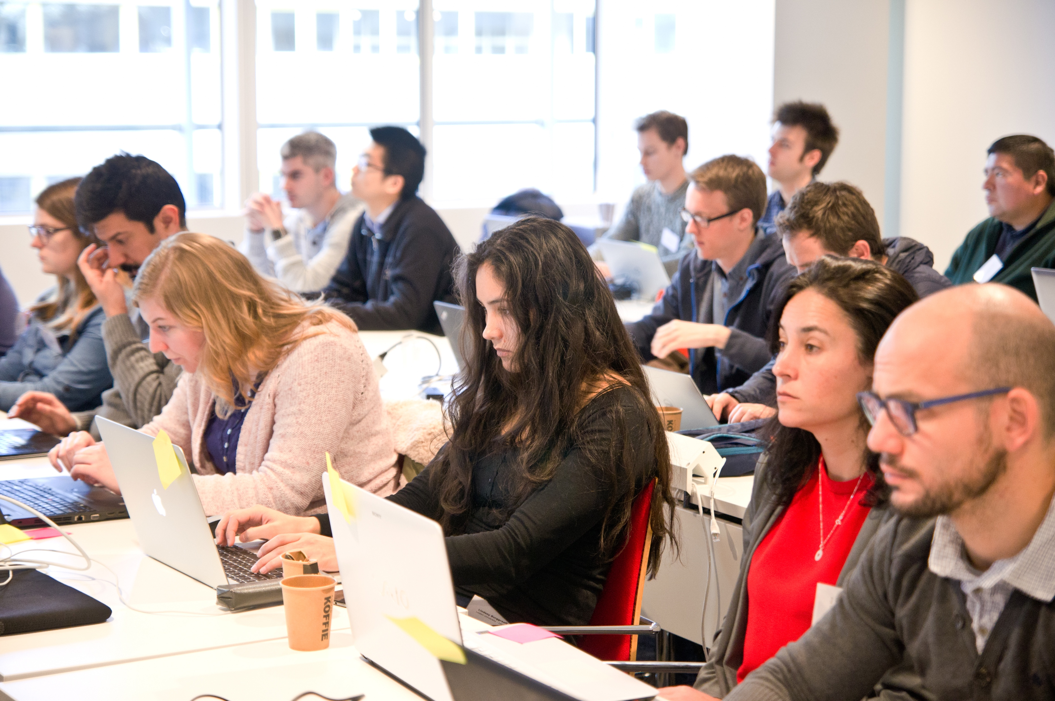

Our Digital Skills Workshops are free and open to researchers in the Netherlands. We also offer paid options of custom workshops dedicated to your organisation. To learn more, contact: training@esciencecenter.nl
Do you want us to come and teach a custom workshop at your organisation?

Slide 6
Do you want to teach with our materials?
All material that we use is open-source available
We can help you setup workshops, contact training@esciencecenter.nl

Slide 7

NL-RSE brings together the community of people writing and contributing to research software from Dutch universities, knowledge institutes, companies and other organizations to share knowledge, to organize meetings, and raise awareness for the scientific recognition of research software.
Website: https://nl-rse.org/
Email: info@nl-rse.org
Twitter: @nl_rse

Slide 8
For this workshop (R-packaging)
Link to teams meeting (every Wednesday 9:00 – 13:00): https://teams.microsoft.com/l/meetup-join/19%3aEyPLywy1nfupUJwOF-p2WTyn8xHUx9jybaQIFJr2U-E1%40thread.tacv2/1690463526219?context=%7b%22Tid%22%3a%22aa3aeacc-6307-42b2-ac05-787dd5c32574%22%2c%22Oid%22%3a%220500b9c6-3c05-4613-be39-e7969f914759%22%7d
Link to collaborative document: tinyurl.com/rpackages-week1
Access to teams channel: we have added you as guest, you should get an invite in your email. Please let us know if you don’t have access at training@esciencecenter.nl

Slide 9
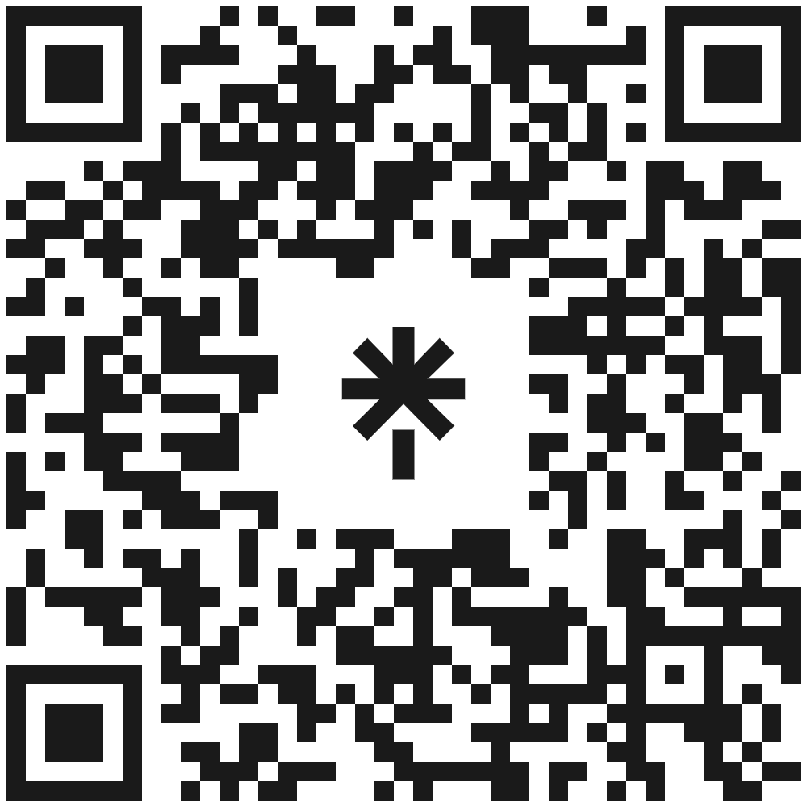







Let’s stay in touch
www.eScienceCenter.nl
info@esciencecenter.nl
+31 (0)20 460 4770
@eScienceCenter
Netherlands Escience Center
@eScienceCenter@akademienl.social

